Slide 1

R Programming
SEMINAR BY:
SHANTANU V. PATIL
GUIDED BY:
Prof P.P.KATGAONKAR

Slide 2
TABLE OF CONTENTS
History
Introduction
R Basics
Features
Comparison with other programming languages
Merits
Demerits
Conclusion

Slide 3
History
R is a programming language it was an implementation over S language. R was first designed by Ross Ihaka and Robert Gentleman at the University of Auckland in 1993.
It was stable released on October 31st 2014 the 4 months ago ,by R Development Core Team Under GNU General Public License.

Slide 4
Introduction
R is a programming language and software environment for statistical computing and graphics. The R language is widely used among statisticians and data miners for developing statistical software and data analysis.
It compiles and runs on a wide variety of UNIX platforms, Windows and Mac OS. R can be downloaded and installed from CRAN website , CRAN stands for Comprehensive R Archive Network.

Slide 5
R Basics
Why R ?
The most extensive modeling resources in scientiﬁc research.
The ﬁne publishing quality graphs.
Easy to develop your own model.
R is freely available under GNU General Public License.

Slide 6
R Package
A Package is a collection of R functions with comprehensive documents.
A Package includes: R functions, Data Example, Help Files, Namespace and Description.
The default installation is kept as minimum.
The function of R could be extent by loading R packages.

Slide 7
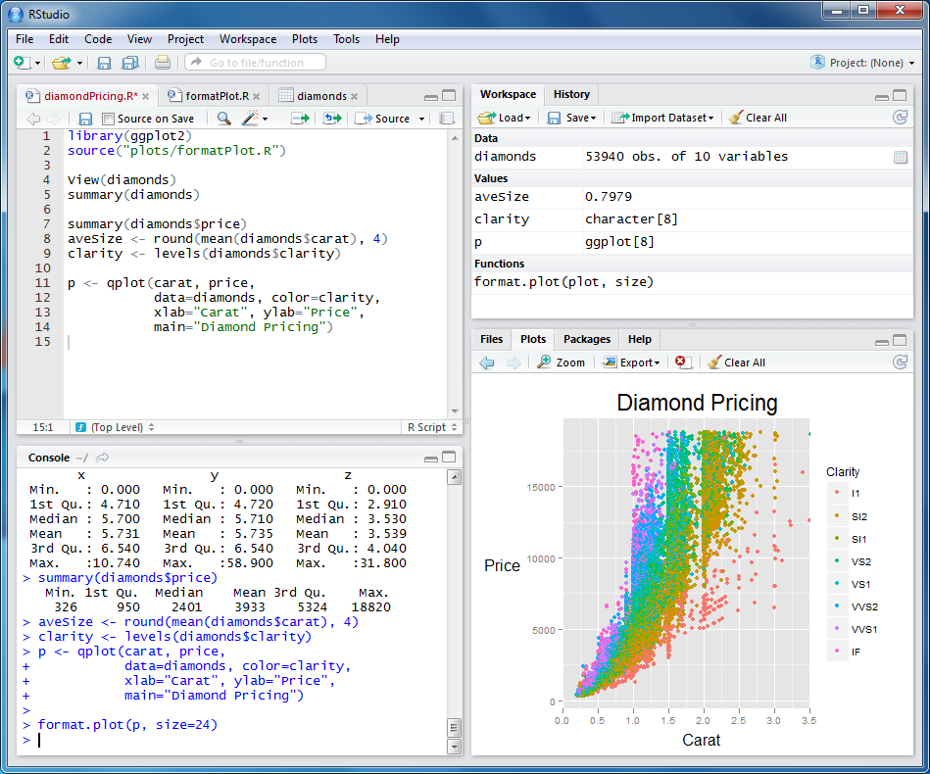
R GUI

Slide 8
Features
Open Source:
The source code of R program and the extensions could be examined line by line.
Integrating with other Programming Language:
R is an interpreting language, can be rather slow, but could integrate with high eﬃcient languages such as C, C++ or Fortran.
OS Independence:
UNIX, Linux, Windows, MacOS, FreeBSD...
Command line Driven:
You have to write Commands...

Slide 9
Comparison with other languages
R Programming | Python | Java
It was stably released in 2014. | It was stably released in 1996. | It was stably released in 1995.
It has more functions and packages. | It has less functions and packages. | It has large number of inbuilt functions and packages.
It is an interpreter base language | It is an interpreter base language | It is interpreter and compiled based language.
It is statistical design and graphics programming language. | It is general purpose language. | It is general purpose programming language designed for web applications .
It is difficult to learn and understand. | It is easy to understand. | It is easy to learn and understand.
R is mostly use for data analysis. | Generic programming tasks such as design of software's or desktop applications. | Java is mostly used in design of windows applications and web applications.

Slide 10
Merits
R is the most comprehensive statistical analysis package available . It incorporates all of the standard statistical tests, models, and analyses, as well as providing a comprehensive language for managing and manipulating data.
R is a programming language and environment developed for statistical analysis by practising statisticians and researchers.
The graphical capabilities of R are outstanding, providing a fully programmable graphics language that surpasses most other statistical and graphical packages. 

Slide 11
R is free and open source software, allowing anyone to use and, importantly, to modify it. R is licensed under the GNU General Public License, with copyright held by The R Foundation for Statistical Computing.
R has over 4800 packages available from multiple repositories specializing in topics like econometrics, data mining, spatial analysis, and bio-informatics.
R is cross-platform. R runs on many operating systems and different hardware. It is popularly used on GNU/Linux, Macintosh, and Microsoft Windows, running on both 32 and 64 bit processors. 

Slide 12
Demerits
R is slow :
Is an interpreting language and is not very fast. Could be 1/40 of C.
Limitation of Memory:
All the objects are in memory.
R is hard to learn:
One has to memorize the commands/functions, and understand the logics of programming. The ﬂuency in R requires great time and energy.

Slide 13
Conclusion

Slide 14
Any Queries?

Slide 15
Thanks..

